Slide 1

ECE 281 Lesson 13
Maj Walchko
1

Slide 2
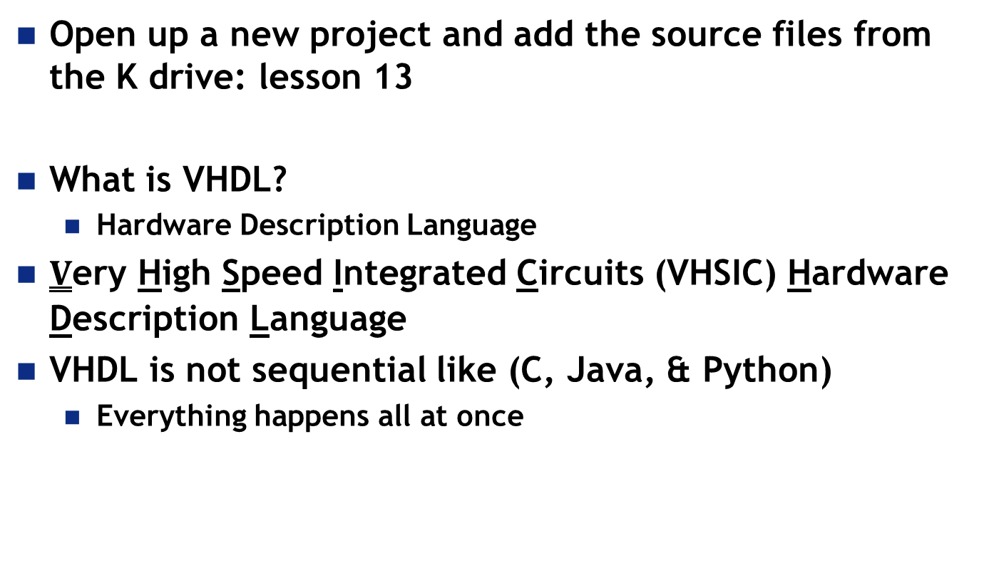
VHDL
Open up a new project and add the source files from the K drive: lesson 13
What is VHDL?
Hardware Description Language
$\underline{V}$ery High Speed Integrated Circuits (VHSIC) Hardware Description Language
VHDL is not sequential like (C, Java, & Python)
Everything happens all at once

Slide 3
Xilinx – VHDL to Board
Transforms text description into Logic Gates
HDL
Synthesis
Translate
.ngd
Map, Place, & Route
Implement, Generate Programming File
.vhd
.ngc
Netlist - How things are connected
.ucf
Unit Constraint File
Target Device
(board specific)
.bit

Slide 4
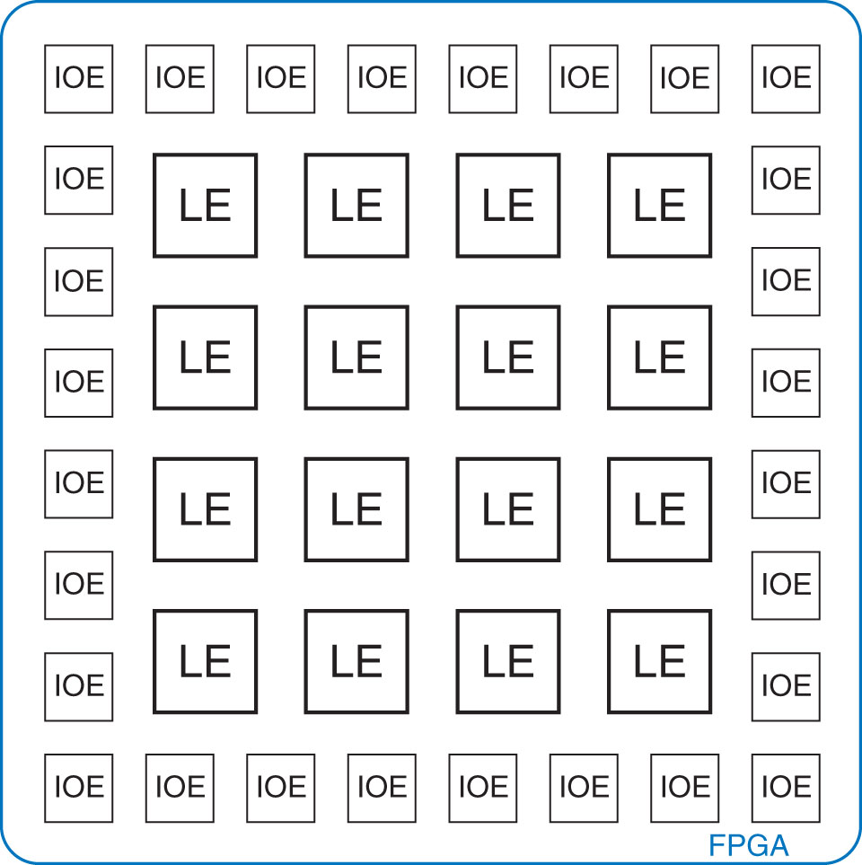
FPGA
Field Programmable Gate Array (FPGA)
Look-up table
Programmable interconnections (IOE)
Made of LEs (Logic Elements) aka
CLB (Configurable Logic Blocks)
Is reprogramable in the field good or bad?

Slide 5
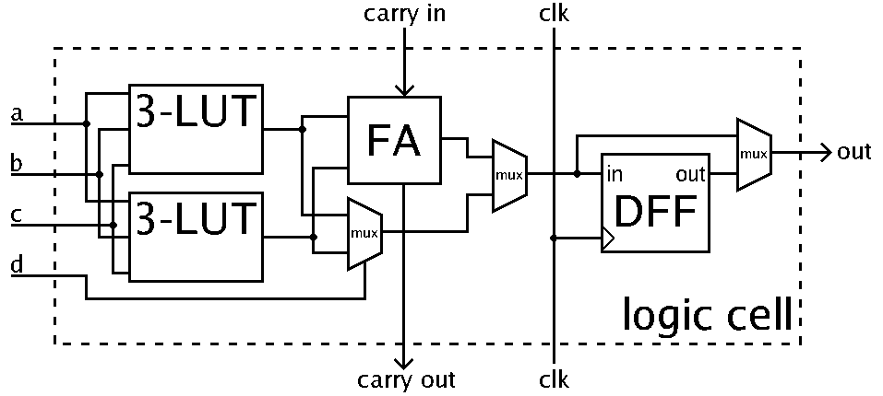
FPGA
Key parts of Logic Elements
Look-up table (LUT)
Flip-flop (1-bit register) (DFF)
Programmable interconnections via Multiplexers
We will talk more about the details later
By Petter.kallstrom - Public Domain, https://commons.wikimedia.org/w/index.php?curid=10224058

Slide 6
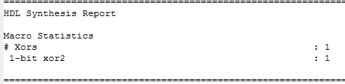
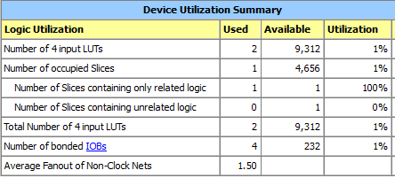
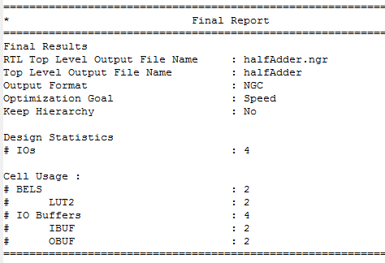
ISE Reports – CE2 Example

Slide 7
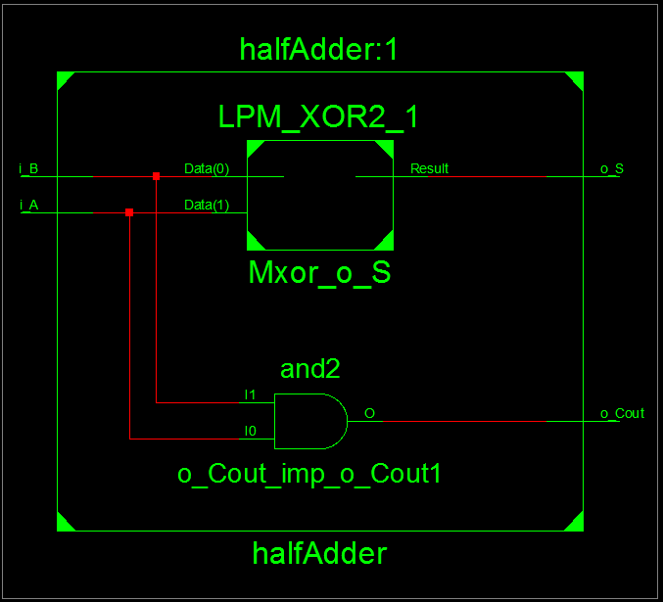
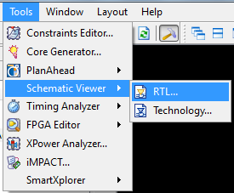
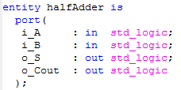

Viewing Schematics – CE2

Slide 8
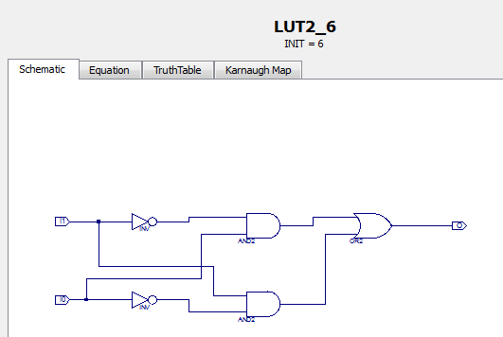
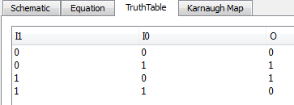
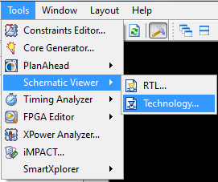
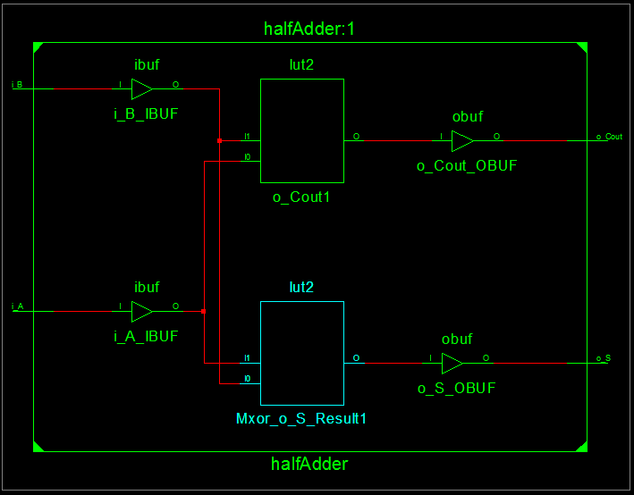
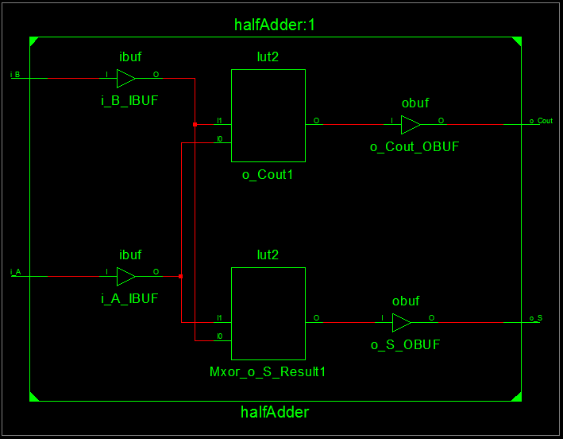
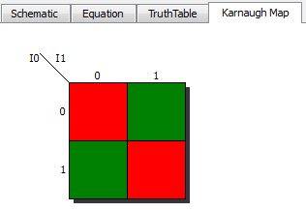
Viewing Schematics – CE2

Slide 9
Standard Logic Values
U – Uninitialized
X – Forcing Unknown
0 – Forcing ‘0’
1 – Forcing ‘1’
Z – High Impedance
W – Weak Unknown
L – Weak ‘0’
H – Weak ‘1’
- – Don’t Care
U | X | 0 | 1 | Z | W | L | H | -
Something probably wrong
Most common
Not commonly used

Slide 10
VHDL
Std_logic_vector – collection of signals in a bus
Entity – Defines inputs and outputs of box
Architecture – Describes what is inside the box
Signal declaration
Each concurrent statement can be thought of as a circuit part
Contains timing information
Arch body can be thought as a “collection of parts”
Modelling:
Behavioral – Describes what module does in terms of the relationships between inputs and outputs
Structural – Describes what a module does in terms of how it is composed of simpler modules

Slide 11
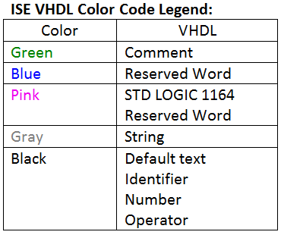
VHDL
library IEEE; -- These lines are similar to a import in python
use IEEE.std_logic_1164.all;
entity ent_name is
Port ( port_name : mode signal_type;
… : … …);
end ent_name;
architecture arch_name of ent_name is
-- signal declarations (behavioral, structural)
-- component declarations (structural)
begin
-- connect your stuff here
end arch_name;

Slide 12
Component Declaration and Instantiation
How Many of you have investigated your testbenches?
Declaration: In Architecture…Before Begin (Make Known)
component Component_Name
port ( -- signal_name : mode signal_type;
Input0, Input1 : in std_logic;
Output :out std_logic);
end component;
Instantiation: In Architecture…After Begin (Component Used)
Component_Label: Component_Name
port map ( -- Port_name => Signal name,
Input0 => a,
Input1 => b,
Output => Y);

Slide 13
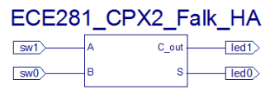
VHDL – Structural Definition
Structural – Describes what a module does in terms of how it is composed of simpler modules
library IEEE; -- These lines are similar to a #include in C or import in python
use IEEE.std_logic_1164.all;
library unisim; -- Use these libraries if you are using primitive components
use unisim.vcomponents.all; -- defines low level logic gates
entity ce2_ha_structural is
Port ( A : in STD_LOGIC;
B : in STD_LOGIC;
S : out STD_LOGIC;
Cout : out STD_LOGIC);
end ce2_ha_structural;
Entity

Slide 14
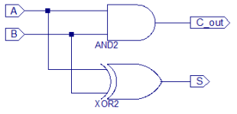
VHDL – Structural Definition
Entity
architecture Structural of ce2_ha_structural is
component AND2
port ( i0, i1 : in std_logic;
o :out std_logic);
end component;
component XOR2
port ( i0, i1 : in std_logic;
o :out std_logic);
end component;
signal s1, s2 : std_logic; -- wires which begin & end in the component
begin
Architecture

Slide 15
VHDL – Structural Definition
begin
unit1: AND2
port map ( -- s1 <= A AND B; (i.e. Cout)
i0 => a,
i1 => b,
o => s1);
unit2: XOR2
port map ( -- s2 <= A XOR B; (i.e. Sum)
i0 => a,
i1 => b,
o => s2);
Cout <= s1;
S <= s2;
end Structural;
Can be omitted for brevity, but it makes code harder to read…and debug!
Entity
Architecture
S1
S2

Slide 16
VHDL – Behavioral Definition
Behavioral – Describes what module does in terms of the relationships between inputs and outputs
library IEEE;
use IEEE.STD_LOGIC_1164.ALL;
entity ce2_half_adder is
Port ( A : in STD_LOGIC;
B : in STD_LOGIC;
S : out STD_LOGIC;
Cout : out STD_LOGIC);
end ce2_half_adder;
architecture Behavioral of ce2_half_adder is
begin
S <= A xor B;
Cout <= A and B;
end Behavioral;

Slide 17
Wakerly Handout
Structural Implementation Example from Wakerly Handout:
https://sharepoint.usafa.edu/academics/eleccompengineering/ece281/Handouts/DDPP%204th%20Wakerly-5-3%20VHDL%20section.pdf
Table 5-30 Structural VHDL program for a prime-number detector.
Uses compact form of port mapping (default bindings)
Easy to mess up!

Slide 18
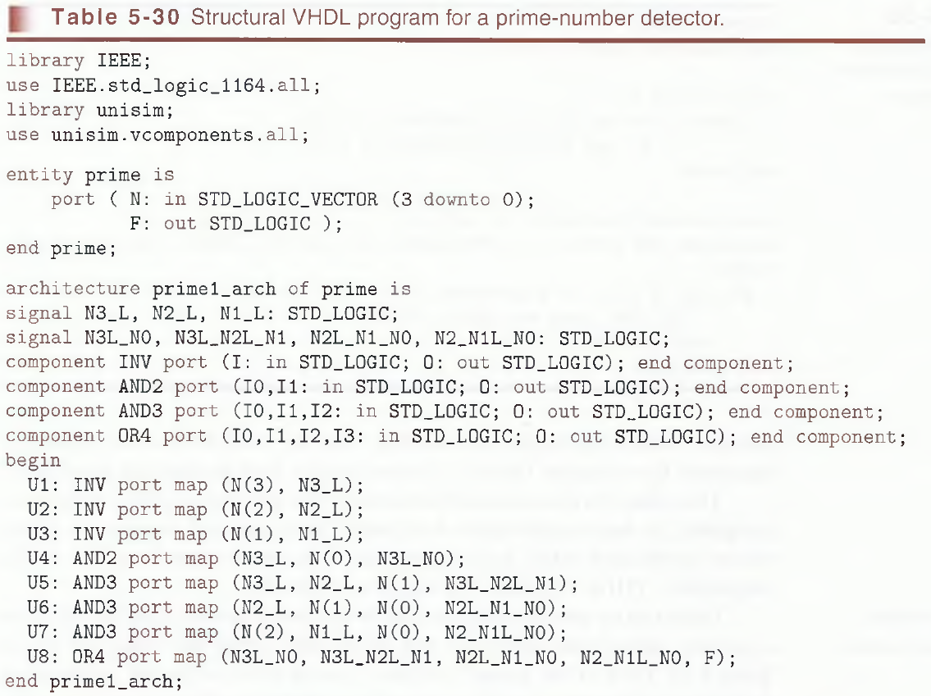
Wakerly Handout

Slide 19
Structural vs. Behavioral
Would behavioral modelling be better for the Wakerly example?
When would you want to use structural?
When would you want to use behavioral?

Slide 20
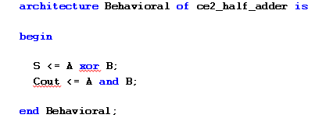
Modelling Summary
Behavioral – Describes what module does in terms of the:
relationships between inputs and outputs
Structural – Describes what a module does in terms of:
how it is composed of simpler modules

Slide 21
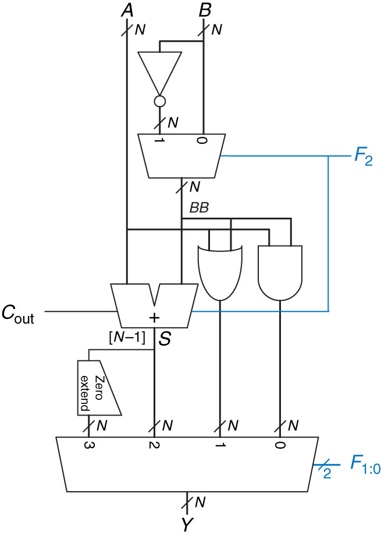
Modelling Summary
Behavioral - better for lower level modules
Structural - better for building up to complex designs

Slide 22
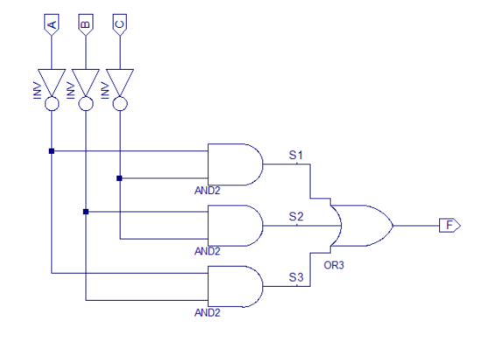
Minority Circuit
Minority Circuit – Output is high if a minority of the inputs are high
Entity
Minority
Truth Table
A | B | C | F
0 | 0 | 0 | 1
0 | 0 | 1 | 1
0 | 1 | 0 | 1
0 | 1 | 1 | 0
1 | 0 | 0 | 1
1 | 0 | 1 | 0
1 | 1 | 0 | 0
1 | 1 | 1 | 0
Architecture
K-map: F = A’C’ + B’C’ + A’B’

Slide 23
Testbenches (Pgs 220 – 224)
Assert (check output)
Report (report message)
Severity (Error, Warning, Note, Failure)
A <= '0'; B <= '0'; C <= '0'; D <= '0' ; S <= "00";
wait for 10 ns;
ASSERT Y = '1' REPORT "Test 0000 00 Failed" SEVERITY ERROR;
-- Can use Error, Warning, Note, Failure
Be Careful with its use: What could be an issue?
Propagation Delay

Slide 24

24

Slide 25
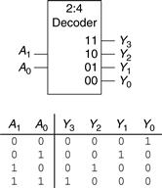
Homework
Exercise 4-13: Build and test a 2 to 4 Decoder Module in HDL
HDL Example 4.35 (pg 219) shows a way to easily create a N:2^N decoder

Slide 26
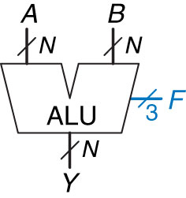
ALU – Block Diagram
ALU: Arithmetic Logic Unit
Combine Math and Logic
Heart of most computers
Has 7 functions
Control Signals
F₂ | F₁ | F₀ | Y
0 | 0 | 0 | A and B
0 | 0 | 1 | A or B
0 | 1 | 0 | A + B
0 | 1 | 1 | Not Used
1 | 0 | 0 | A and B’
1 | 0 | 1 | A or B’
1 | 1 | 0 | A – B
1 | 1 | 1 | set <

Slide 27

ALU – Block Diagram
Build an ALU with logic Functions:
What do we need?
Adder
Inverter
And
Or
Mux
Comparator
Control Signals
F₂ | F₁ | F₀ | Y
0 | 0 | 0 | A and B
0 | 0 | 1 | A or B
0 | 1 | 0 | A + B
0 | 1 | 1 | Not Used
1 | 0 | 0 | A and B’
1 | 0 | 1 | A or B’
1 | 1 | 0 | A – B
1 | 1 | 1 | set <
How would we design this? Let’s draw it out …

Slide 28
ALU
Figure 5.15 N-bit ALU

Slide 29
Wakerly Handout
Structural Implementation Example from Wakerly Handout:
https://sharepoint.usafa.edu/academics/eleccompengineering/ece281/Handouts/DDPP%204th%20Wakerly-5-3%20VHDL%20section.pdf
Table 5-30 Structural VHDL program for a prime-number detector.

Slide 30
Viewing Schematics – CE2

Slide 31
Viewing Schematics – CE2

Slide 32
ISE Reports – CE2 Example

Slide 33
FPGA
Key parts of Logic Elements
Look-up table (LUT)
Flip-flop (1-bit register) (DFF)
Programmable interconnections via Multiplexers

